Slide 1

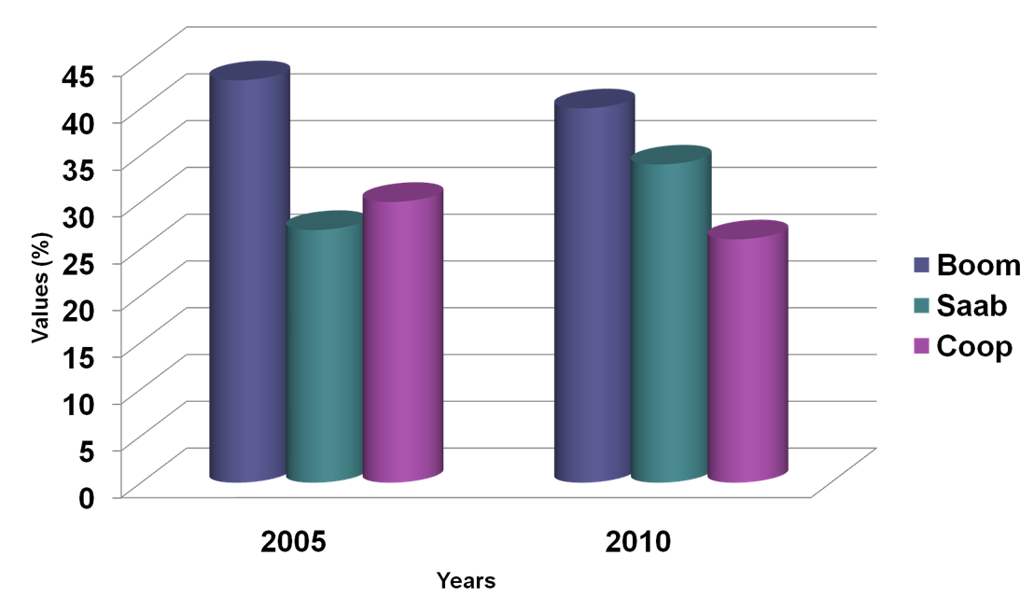
POSTER TITLE
Abbreviation first name then last name (Example: P. Sudiarta), and so on for other authors
Affiliation Corresponding author: email@email.com
This poster template is intended for writers in ICoSTH 2018, present their paper in form of posters. Prepare a poster that will be presented at in ICoSTH 2018 in Powerpoint by following the instructions below and then printed in the form of a roll banner.
Poster size 84 cm x 118 cm Portrait (A0).
Provisions Content of Posters: Introduction, Research Methods, Results and Discussion, Conclusion, Bibliography
3. Fonts and Sizes
  Title Poster: 60 point Arial, font bold, center aligned.
  Author: 36 point Arial, center aligned.
  Affiliation: 30 point Arial, italic, center aligned.
  Heading: Bold, all capitals, 44 point Arial Narrow, left aligned.
  Sub-headings: bold, 36 Arial Narrow, left aligned, underlined.
  Main text: 30 point Arial Narrow, justified.
  Bibliography: 30 point Arial Narrow, justified with 1 cm first line indent
4. NO: 000 (on the top right side of the poster) the poster code that will be given by
committee when given LoA
Figure 1. Example Chart
Table 1. Experimental Data
Prodauctaaaa | Banana | Apple
Material | Water | Air
Flow Soeed (m/s) | 0.05 | 6.6
Introduction
Introduction contains are background, problems and objectives of research, community service and supporting literature study
Conclusion
Answer research objectives and can be supplemented with suggestions.
Research Methods
Methodology can be explained in this section. Recommended to use a flowchart to make it easier for understand the method
Thank You Note
Thank you to those who support the writing of the paper
Results and Discussion
The results of the study are described in this section.
Bibliography
Goldman, C. R. and A. J. Horne. 1983. Limnology. International Student Edition. Mc. Graw Hill. Int. Book. Co. Tokyo.
Rapaglia, John P., and Henry J. Bokuniewicz. 2009. The effect of groundwater advection on salinity in pore waters of permeable sediments. Limnology and Oceanography. Vol. 54(2) : 630-643.
Ahalya, N and Ramachandra T.V. 2001. Wetlands Restoration and Conservation – What, How and Why? Proceedings of National Conference on Control of Industrial Pollution and Environmental Degradation. September 14-15, 2001. PSG College of Engineering, Coimbatore : 560-564.
Kreith, F. and J. Kreider, 1978, Principles of Solar Engineering. New York: Hemisphere-McGraw-Hill. (for Book)
Chianelli R. R., M. Daage, and M. J. Ledoux, 1994, Fundamental studies of transition-metal sulfide catalytic materials, In Advances in Catalysis, Vol. 40, edited by D. D. Eley, H. Pines, and W. O. Haag. Burlington, Mass.: Academic Press. (for Contribution to a Book)

